Slide 1
Explore AI for All

Slide 2
Introduction
AI for All focuses on how AI can benefit everyone.
It explores AI's role in accessibility, employment, humanitarian work, and inclusion.

Slide 3
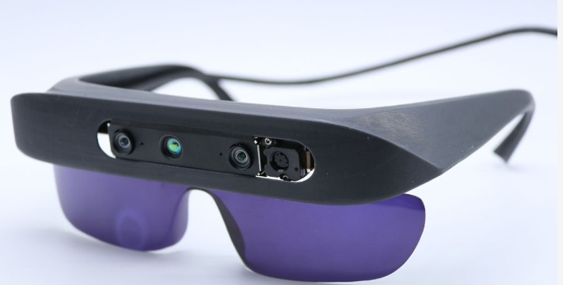

Slide 4
2. Impact of AI on Accessibility
AI can help people with disabilities use technology more easily.
Examples:
Speech-to-text → converts spoken words into text.
Text-to-speech → reads text aloud.
Image recognition → describes images for people with visual impairments.
Automatic captions → helps people with hearing difficulties.
AI can make digital content more accessible and inclusive.

Slide 5
Impact of AI in Job Roles
AI is changing how people perform their jobs.
It can automate repetitive tasks and help employees work faster.
AI may create new job roles and skills while changing existing ones.
People need to develop AI literacy and new skills to adapt.

Slide 6
AI as an Ally for Humanitarian Action
AI can support organizations during disasters and humanitarian crises.
Uses include:
Analyzing disaster information
Identifying affected areas
Supporting emergency planning
Translating languages
Helping distribute resources

Slide 7
Inclusive AI with Copilot
Microsoft Copilot can support people with different abilities and needs.
It can help with writing, summarizing, explaining, brainstorming, and communication.

